Slide 1
CMPE 220
Class 29 – Interesting Stuff, Past and Future
Notes:
Let’s talk about history.
California State Railroad Museum – 1976 - docents worked on original steam engines.

Slide 2
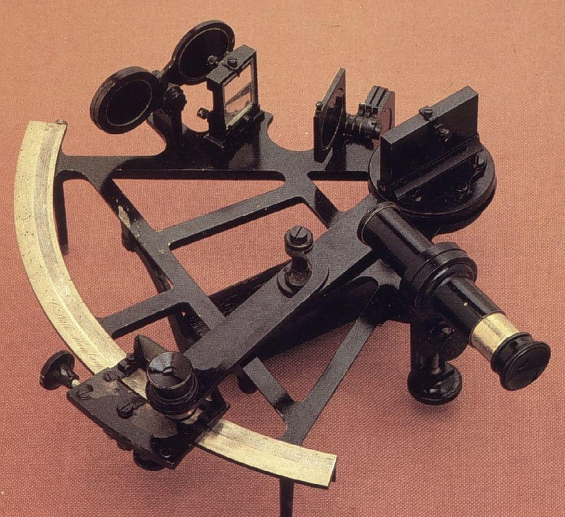
The Babbage Difference Engine
Designed and partially built by Charles Babbage c. 1820
A programmable mechanical computer used wheels with ten digits
Designed to repetitively calculate mathematical functions
Funded by the British Royal Navy to compute tables used for navigation with a sextant and timepiece
At the time, navigation tables were calculated by hand
The difference engine would have greater precision, and more accurate navigation
The metalworking techniques of the time did not allow the full machine to be built, and the project was abandoned in 1842

Slide 3
The Babbage Difference Engine
Babbage designed an improved machine, Difference Engine #2, in 1847-1849
Over 8,000 parts, including a mechanical printer
Over 4 tons, and 8 feet high
Capable of calculating 16 digits
In 1991, the Science Museum in London built Difference Engine #2 from Babbage’s plans, and demonstrated than the machine actually works!
The printer was built and added in 2002
A second machine was funded by Microsoft CTO Nathan Myhrvold and was exhibited at the Computer History Museum in Mountain View from 2008 to 2016

Slide 4
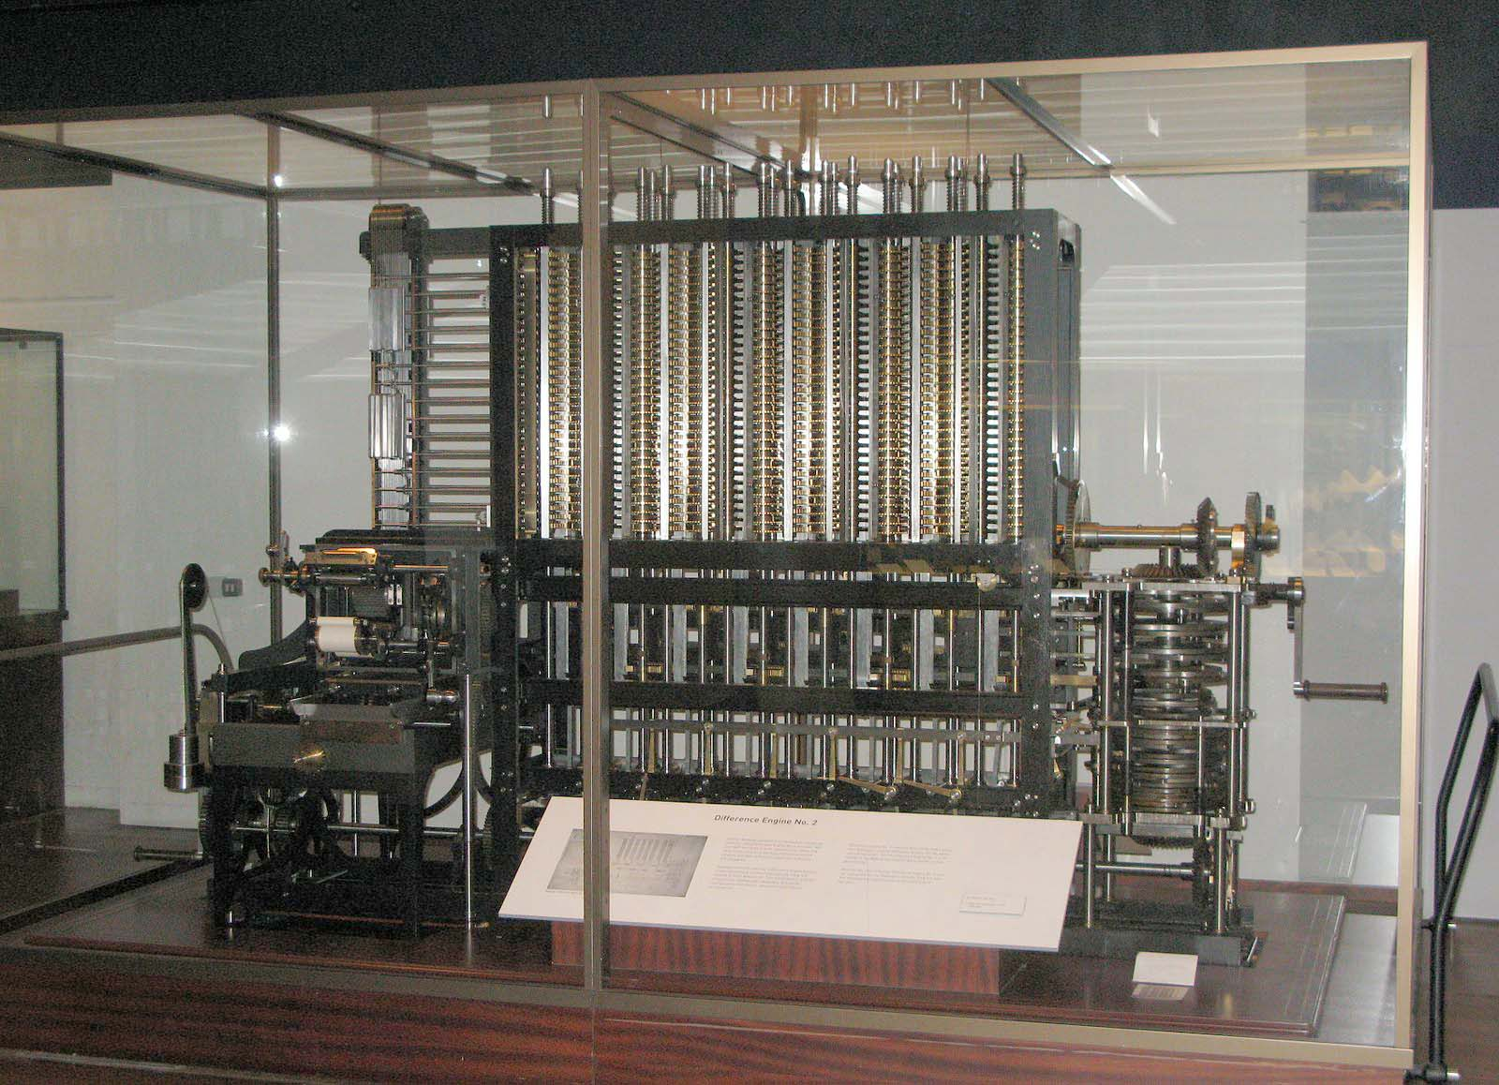
The Babbage Difference Engine #2

Slide 5
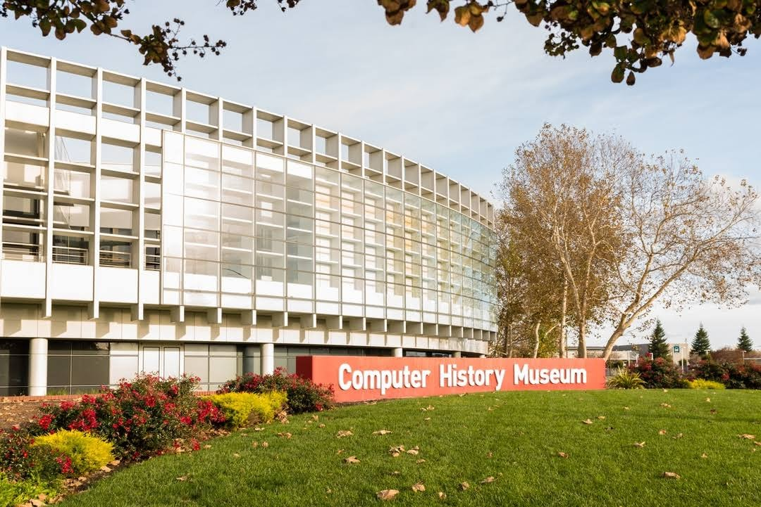
Computer History Museum – Mountain View
https://computerhistory.org/

Slide 6
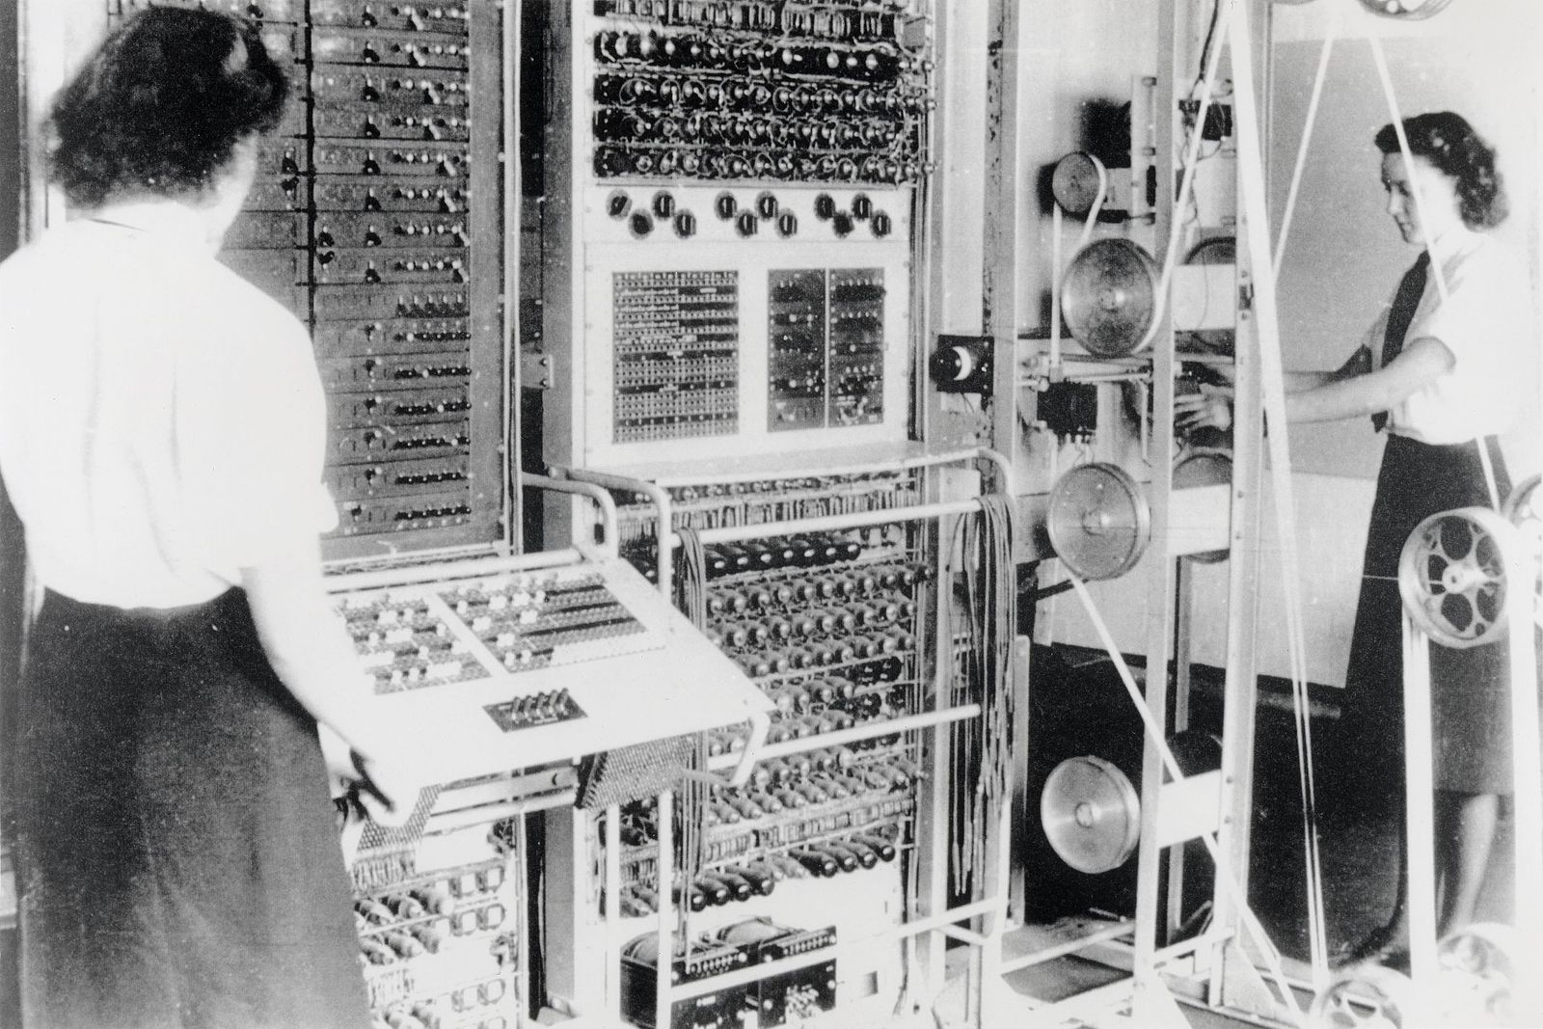
Electronic Computers - Collosus
Colossus – a series of computers built by the British government in 1943-1945, used to break German codes during WW II
Alan Turning contributed to the design
Kept Secret until 1970!

Slide 7
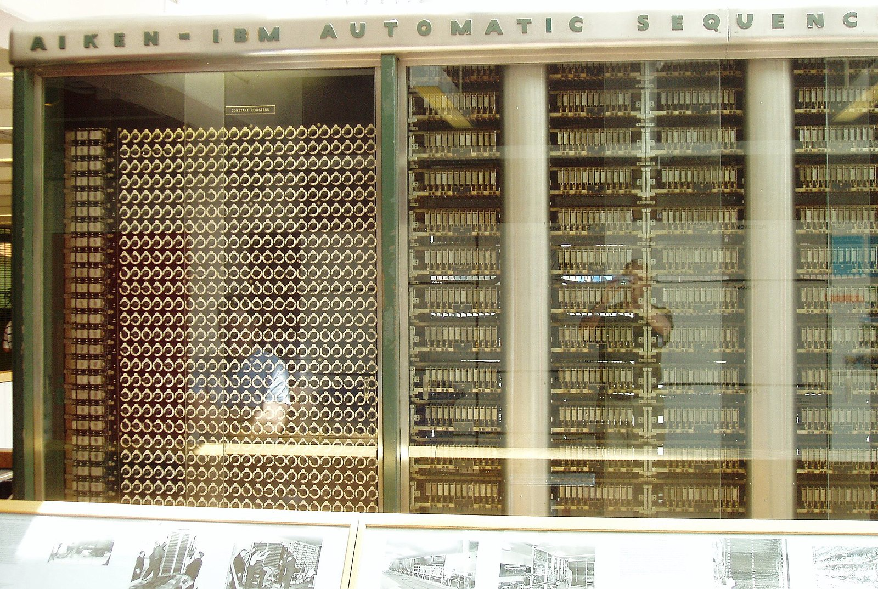
Electronic Computers – Harvard Mark 1
Harvard Mark 1 (aka IBM Automatic Sequence Controller) – completed in 1944 and used by the US government during WW II
John von Neumann used the Mark 1 for calculations for the Manhattan project
Grace Hopper worked on the Mark 1

Slide 8
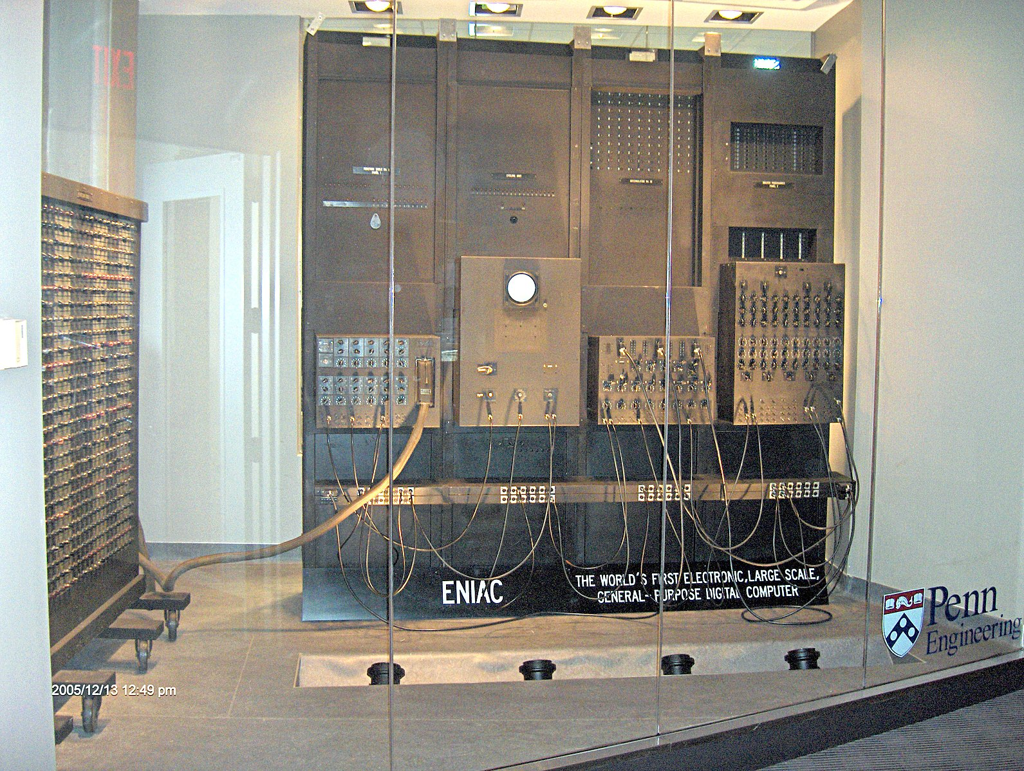
Electronic Computers - Eniac
Electronic Numerical Integrator and Computer (ENIAC) – completed in 1945 and used for artillery calculations
Considered the first general purpose programmable computer
Grace Hopper was senior mathematician

Slide 9
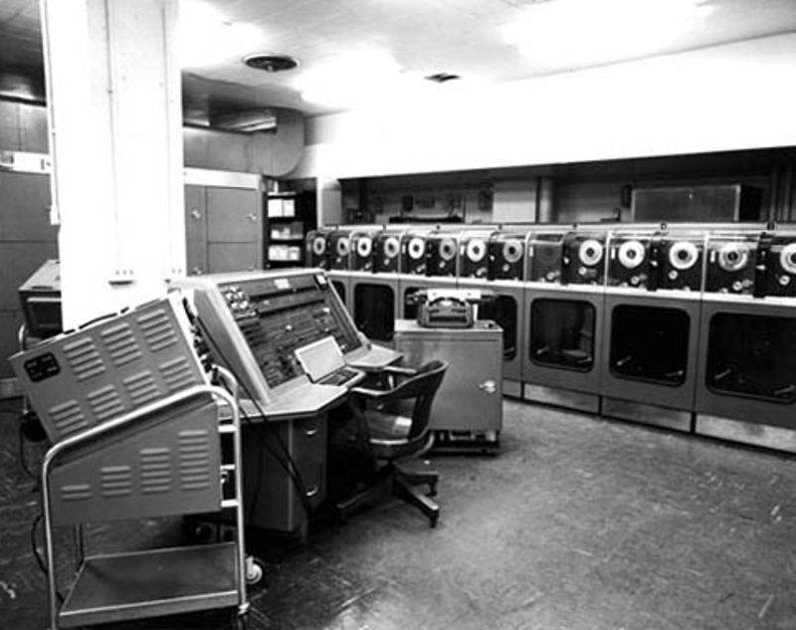
Electronic Computers - Univac
Univac– the first commercial computer, delivered to the US census bureau in 1951
Designed by Presper Eckert and John Mauchly, the creators of the ENIAC

Slide 10
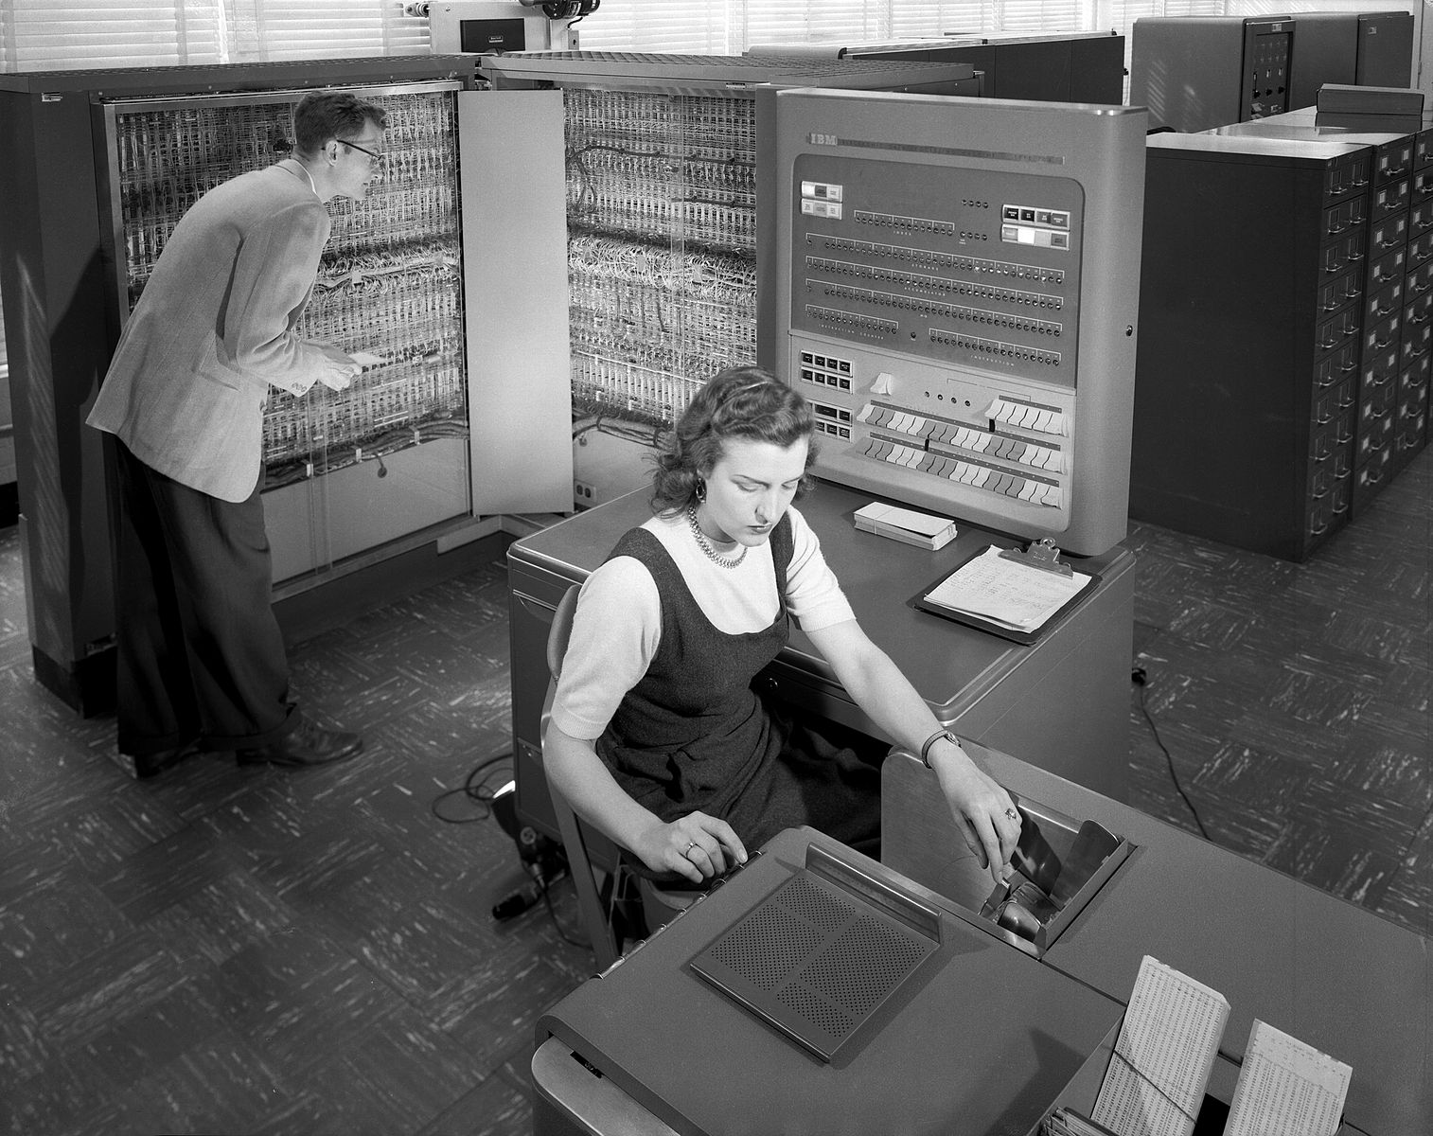
Electronic Computers – IBM 704
A successor to the IBM 701, it featured floating-point arithmetic and magnetic core memory
John Backus and his team developed the first FORTRAN compiler for the 704 in 1956

Slide 11
Operating Systems: Job Control Programs
Batch Operating Systems (mid 1950s) - Loaded and ran programs sequentially
A small “job control program” to remain resident in memory.
This was a tradeoff. It used (precious) memory, but it made more efficient use of the computer
Batch processing
Moved on quickly when programs didn’t work
Did not require the programmer to be present
This began a slippery slope
Saving work from programmers by adding functions to the resident job control program. Programming became simpler, but the control programs got bigger.

Slide 12
The First Operating Systems
The first operating system used for real work was GM-NAA I/O, produced in 1956 by General Motors' Research division for its IBM 704
Most other early operating systems for IBM mainframes were also produced by customers
The state of affairs continued until the 1960s when IBM, already a leading hardware vendor, develop a single operating system for their new hardware, the OS/360 – released in 1964

Slide 13
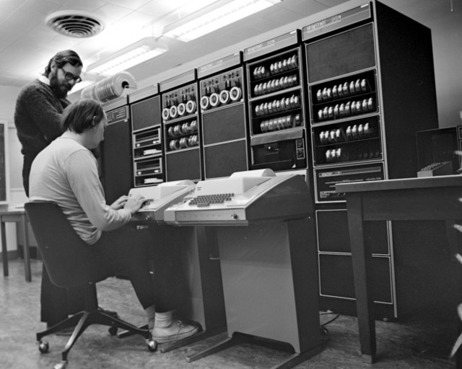
Unix: the “Grandfather” of Operating Systems
Developed by Dennis Ritchie and Ken Thompson, working at Bell Labs, in 1970
Ritchie and Thompson at a PDP-11 computer, from DEC (Digital Equipment Corporation)

Slide 14
The Evolution of Operating Systems
Operating System | Year | Lines of Code
OS/360 | 1964 | 1 million
Windows 3.1 * | 1993 | 5 million
MacOS X.4 (Tiger) | 2004 | 86 million
Debian 5.0 Linux | 2009 | 340 million
Google’s entire codebase – for all products and services – is over 2 billion lines of code

Slide 15
Malware
The Creeper – the first virus. Developed by Bob Thomas of BBN (Boole & Babbage Networks) in 1971 as a non-malicious proof-of-concept for a self-replicating program. It printed a message: “I’M THE CREEPER. CATCH ME IF YOU CAN!”
Rabbit – the first malicious virus. Developed in 1974, it was a malicious virus that consumed system resources until the system crashed.
Animal – the first Trojan. Developed by John Walker in 1975; it was a game program that relied on users to install it, and then copied itself to other locations on the user’s computer.
The term "computer virus" was coined in 1983 by Fred Cohen in one of the first ever published academic papers on computer malware.

Slide 16
Malware
Brain– the first PC (DOS) virus. Release in 1986 on floppy disk. Marked sectors of the disk as bad and wrote a message to those sectors, slowing down the disk. It was originally intended to protect a commercial software product by installing itself if the original software was copied.
nVIR – the first Macintosh virus. Appeared in 1987.
WinVer 1.4 – the first Windows virus. Appeared in 1992.

Slide 17
Anti-Malware
The earliest anti-virus programs appeared in the mid-1980s.
The first may have been developed for the Atari ST personal computer in 1985; another was released in 1987.
Symantac Antivirus for Macintosh (SAM) was released in 1990, and was the first antimalware program that could be updated with signatures of new viruses as they appeared.

Slide 18
Some Random Computer Trivia
Bill Gates originally wanted to call Windows “Interface Manager,” but was eventually persuaded that the program needed a more intuitive name.
Oracle Corporation was founded in 1977 by Larry Ellison and Bob Miner. Miner originally wanted to develop a word processor; Ellison wanted to develop a database. The decision was made by the flip of a coin.
Microsoft Office (Word, Excel, and PowerPoint) was released first on Macintosh in 1989; it wasn’t released for Windows until a year later, in 1990.

Slide 19
The Future
Read the Research
Incremental Refinement
Better algorithms for scheduling, virtual memory, file management, etc.
Increased Virtualization
Security: “certified” operating systems
Specialized systems (IoT, Real Time, Cloud)
Ritchie and Thompson would clearly recognize today’s operating systems – 50 years later!
Dominated by Windows, Macintosh, Linux, iOS, Android
Little room for new entries in existing markets
New systems will arise out of a paradigm shift

Slide 20
Future Directions
Quantum Operating Systems
Blockchain Operating Systems
Artificial Intelligence Operating Systems

Slide 21
Quantum Computing
Quantum Computers today are more like specialized processors…. like a GPU
They perform one task very well
Minimal (or non-existent) OS
Each quantum computer has a unique language & OS
The UK is funding development of a ”standard” quantum computer operating system
The goal is portability across quantum computers
What does a quantum operating system do?
Job controller (similar to 1950s OS)

Slide 22
Blockchain Operating Systems
Blockchain services are integrated into the OS, just like networking is integrated into a network OS
Currently implemented as a virtual system.
Secure, private, anonymous communications
Ledgering of all interactions
What is a Blockchain Operating System? (2018)
https://www.forbes.com/sites/adrianbridgwater/2018/07/03/what-is-a-blockchain-operating-system/

Slide 23
AI-Based Operating Systems
History: a Dead-End
AI research and development began in the 1980s with “expert systems”
Expert systems attempted to replicate human reasoning
Moderately successful for some classes of problems
Expensive to develop
Easy to understand and debug

Slide 24
AI Today
Neural networks, machine learning, generative systems
Based on mathematical models
Arrives at conclusions using methods that are completely unrelated to human reasoning
Relatively inexpensive to develop
Extremely difficult to understand and debug

Slide 25
Rethinking Operating Systems Using AI (AIOS)
Two Directions
An operating system built to support AI – essentially an AI application tightly coupled with the underlying OS (which is more or less convention)
An operating system built using AI to provide OS functions
Google, Microsoft, and others are working on both

Slide 26
1) Supporting AI
Deep Learning OS (DLOS): This is an open-source operating system developed by NVIDIA that is optimized for deep learning applications
AIOS: This is an AI operating system developed by IBM that is designed to help developers build and deploy AI applications
Neuromorphic Computing Operating System (NCS): This is an operating system developed by Intel that is designed for neuromorphic computing, which is a type of computing that is modeled after the human brain
Brainwave: This is an AI operating system developed by Microsoft that is optimized for running deep neural networks
Nengo: This is an open-source software package for building and simulating large-scale neural models, which can be used as an operating system for AI applications

Slide 27
2) AI-Based Operating System
AI used to improve algorithms for scheduling, VM, etc
AI used to rethink fundamental OS architecture
E.g., do we need a scheduler?
“The complexity of AI could make it hard for people to understand and fix any issues, or to configure and tune the system.”

Slide 28
2) AI-Based Operating System
Research
AI and the future of operating systems (2016)
https://content.iospress.com/download/information-services-and-use/isu794?id=information-services-and-use%2Fisu794
AI Spells the End of OS as We Know It
https://www.bloomberg.com/opinion/articles/2023-04-19/ai-is-challenging-operating-system-supremacy#xj4y7vzkg
AI Based OS – Future of Operating Systems (2023)
http://www.ijtrd.com/papers/IJTRD22752.pdf
Artificial Intelligence in Operating Systems (2019)
https://www.academia.edu/42919002/Artificial_Intelligence_in_Operating_System
Artificial Intelligence in Operating System (2019)
https://dl.acm.org/doi/abs/10.1145/3374587.3374635
Artificial Intelligence in Distributed Operating System
https://citeseerx.ist.psu.edu/document?repid=rep1&type=pdf&doi=dc78dd40d28f616386e14f72564d8a005af79faf

